Slide 1
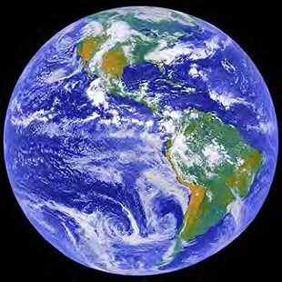

The Greenhouse
Effect
What is it?
Notes:
Discuss what students think they know about this word before diving deeper.
Begin this section by setting up the lab described in the lesson plan to compare how heat is trapped in three tanks.

Slide 2
What are greenhouse gases?
Any gases that cause the “greenhouse effect!”
water vapor
methane
carbon dioxide
nitrous oxide
Imagine… a car on a cool but sunny day…
Notes:
What are greenhouse gases?
Any gases that cause the greenhouse effect!
Includes water, carbon dioxide, methane, nitrous oxide, and several other very long-named chemicals (generally only created by very specific industrial processes)
NOTE – Water is definitely the major greenhouse gas. However, water is in a very set cycles, – what goes up, comes back down
Thus far, human-produced greenhouse gases simply go up; very little is taking them back out

Slide 3
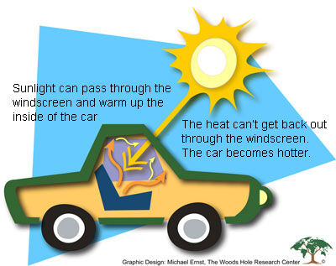
Notes:
What is the greenhouse effect?
A greenhouse (or car) is generally warmer than the air outside it because sunlight and heat pass through the glass into the car, but heat is then trapped in the car, making it warmer

Slide 4
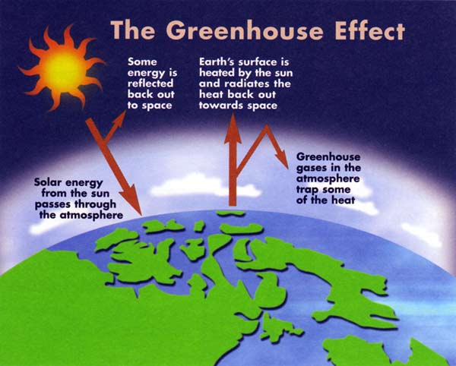
Notes:
In Earth terms:
Sunlight enters our atmosphere (some rays don’t penetrate and are already lost to space)
Some of the heat from the sun is absorbed by our planet, but much of it is reflected back
Most of that heat should pass through the atmosphere back into space
HOWEVER – greenhouse gases “trap” the heat and keep it in our atmosphere
After completing this section, refer back to the lab set up and ask students to relate the parts of the lab to the parts of the Earth in the image above.

Slide 5
GLOBAL
CLIMATE CHANGE
What is it?
Notes:
Now that we’ve created our own definition of this word, let’s look at it a little more closely.

Slide 6
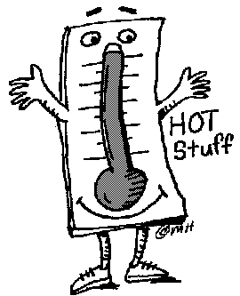
Global Climate Change
Identifiable change in the climate of Earth as a whole that lasts for an extended period of time (decades or longer)
  When due to natural processes, it is usually referred to as global climate variability
  Usually refers to changes forced by human activities that change the atmosphere
Notes:
What is it?
Identifiable change in the climate of Earth as a whole that lasts for an extended period of time (decades or longer)
When it occurs by natural processes – we call it climate variability
Usually refers to changes caused by human activities
Often referred to as global warming since the temp is increasing
Compare that definition to ours created in class

Slide 7
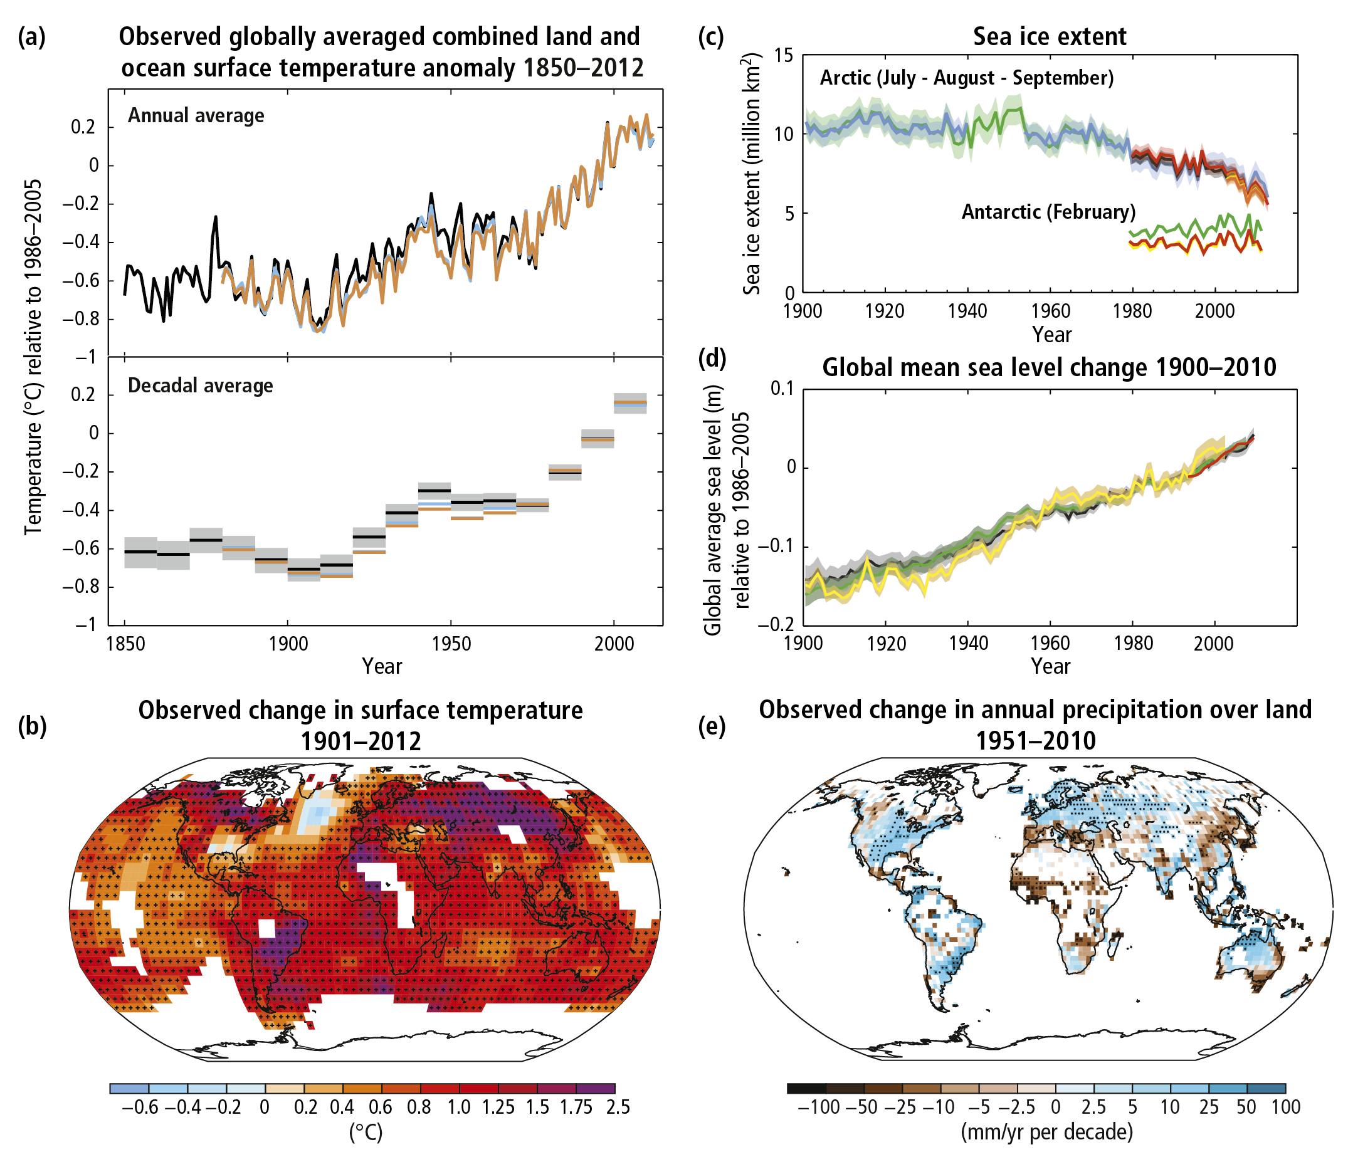
Climate Changes Currently Happening
Notes:
Ask students to examine the graphs and explain their meaning – you might assign different groups different parts and then discuss as a whole.
Shows the combined land and ocean temperature increase over time in the past 162 years. Bottom shows the averages for an entire decade, so there’s less “noise” – also makes the recent rapid increase more evidence – the boxes aren’t even touching the temperature has increased so much.
Shows the overall surface temperature increase over 100 years. In almost all areas, it has increased by at least a few degrees.
Sea ice is dropping, partially in the Arctic ocean – the temperatures are warmer and so there is less ice in those regions.
Sea level changes in past 110 years – also increasing.
Changes in precipitation over land in past 59 years – this is a more variable change. Some areas are the same, while other areas are getting significally more rain and others significantly less.

Slide 8
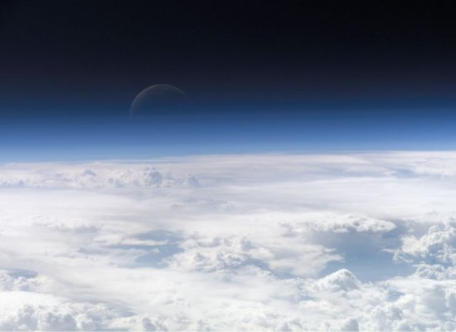
What causes Earth’s climate to change?
Changes in the atmosphere
Natural processes
  Volcanoes
  Tectonic plate movement
  Changes in the sun
  Shifts in Earth’s orbit
Human activities – any activity that releases “greenhouse gases” into the atmosphere
Notes:
Overall caused by changes in the atmosphere – 2 major possibilities
Natural causes
Volcanoes – release gases and particles into the air
Plate tectonic changes – changing the location of landmasses on Earth affects wind and current patterns, which create climate patterns
Solar changes – the sun can become hotter or cooler over time as it ages
Orbit changes – Earth’s orbit does occasionally change, but it happens very slowly, over tens to hundreds of thousands of years.
Human activities – any activities that release “greenhouse gases” into the atmosphere
Includes burning fossil fuels, burning forests or grasslands, industrial activities, agriculture

Slide 9
GLOBAL
CLIMATE CHANGE
Well, what do the data say?
Meet an Ice Core Scientist
Notes:
(While it may sound silly, What do the data say is correct since data is plural.)
Now that we know what we’re talking about and how many people have been examining it, let’s look at what the actual data say.
The students should now complete the “Getting to the Core: Investigating the Link Between Temperature and CO2” if desired – you can also look at the graphs if time is an issue.
Link to video on ice cores - https://www.youtube.com/watch?v=TDOQIkiIL9Q&feature=related

Slide 10
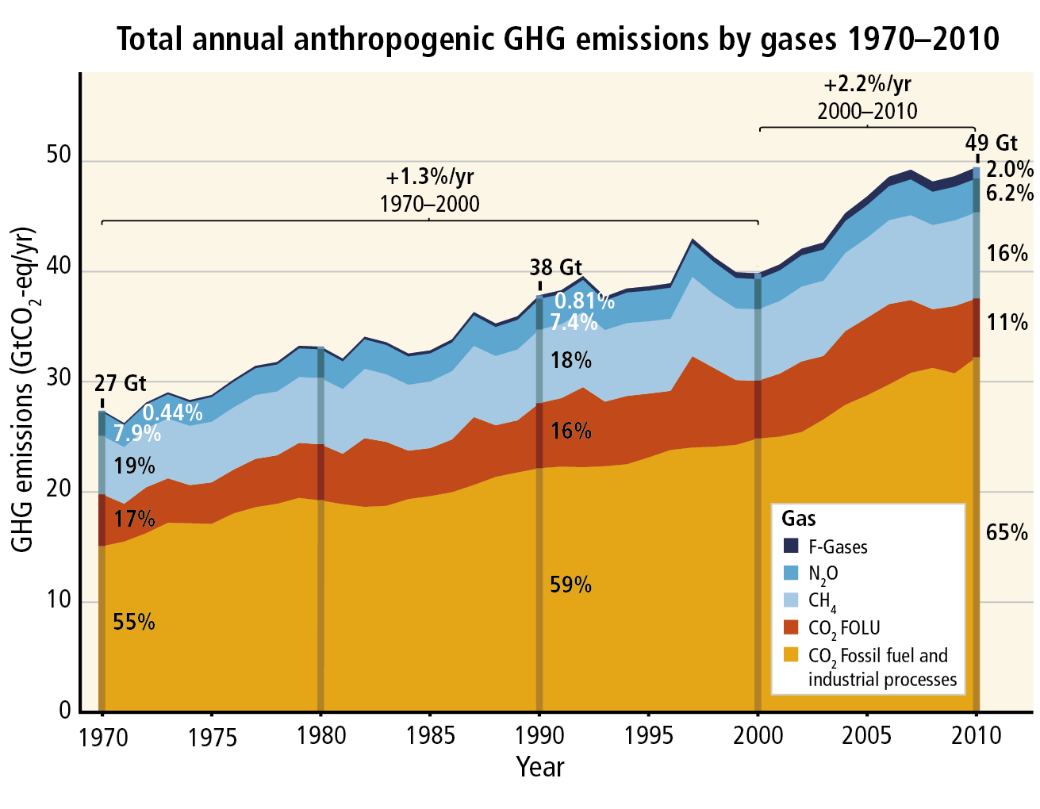
What does this graph mean?
Notes:
The levels of anthropogenic GHG are rising every year – especially CO2. (In the graph, CO2 FOLU stands for Forestry/Other Land Use.) The percent increases at the top are particularly interesting because we have increased the amounts even more in the first decade of this century than in the 30 years prior.

Slide 11
What about those natural processes that can cause climate change?
Click to explore these natural processes at the EPA website!
Notes:
Click the link for an interactive look at three of the natural causes of climate change – all three should be cooling the planet, rather than warming it.

Slide 12
IPCC Conclusion:
“Their effects [those of human-caused greenhouse gases], together with those of other anthropogenic drivers, have been detected throughout the climate system and are extremely likely to have been the dominant cause of the observed warming since the mid-20th century.”
Notes:
IPCC statement from the 2014 summary report for policy makers.
The Intergovernmental Panel on Climate Change (IPCC) is the international group formed by the United Nations to investigate climate change. It consists of hundreds of scientists around the world who pull together thousands of studies on climate, gases, atmospheric conditions, ecosystem changes, etc., etc. to make conclusions about climate change on our planet. The reports they produce take approximately 10 years often to complete as they are reviewing by hundreds of other scientists and the governments of the United Nations before final publication.

Slide 13
GLOBAL
CLIMATE CHANGE
What's going to happen?
Notes:
While there is no way to know 100% what will happen due to global climate change, we can use computer simulations as well as evidence of changes already occurring to make conclusions about probable future effects.

Slide 14

Warming and sea level rise will continue and will probably occur more quickly than what we’ve already seen
Even if greenhouse gases are stabilized, this will probably continue to occur for centuries
Some effects may be permanent
Possible Future Effects
Notes:
It is very likely that warming and sea level rise will continue and will very likely be larger than those already seen
Even if greenhouse gases are stabilized, warming and rising sea levels may continue to occur for centuries – we started rolling a really big ball downhill, it will take a while for it to stop now, even if we’re not pushing it anymore.
Some effects of warming (such as loss of glaciers) may be permanent. That’s not to say that more glaciers can’t form. But with the uneven distribution of warming on our planet, some areas will most likely have their climates altered for the foreseeable future (within many generations of human life).

Slide 15
Effects on Ecosystems
  Coral systems and other unique ecosystems cannot handle higher temperatures well
  Wildfires will increase
  Up to 30% of species will be at increased risk for extinction due to the rapid changes in their ecosystems
Possible Future Effects
Notes:
These are model predictions of what happens to ecosystems with greater increased temperatures and sea levels – only effects seen with a 1-2°C temp rise and sea levels rising at their current rate are included
Effects on ecosystems:
Many coral systems will collapse due to bleaching (coral death)
Wildfires will increase; increased heat and decreased precipitation in some areas
Up to 30% of species will be at increased risk of extinction due to climate change in their ecosystems

Slide 16
Effects in North America
  Warming in western mountains: several effects
  Increased rain: will actually help some crops
  Heat waves will increase in number, length, and intensity
  Coastal communities will be affected by increased flooding and storms
Possible Future Effects
Notes:
Effects in North America:
Warming in Cascade and Rocky Mountains would cause less snow pack, increased winter flooding, and reduce water in summer (less snow to melt and run down the mts)
In certain areas, rain-fed crops will actually increase (decreased rain in one area is generally going to mean increased rain in others, though this may increase flooding in some areas, too)
Heat waves will likely increase in number, length, and intensity
Coastal communities and ecosystems will be affected by rising sea levels (increased floods and storms) (NOTE – This will be a much bigger problem in poorer countries with few resources to move populations or adapt to changes)

Slide 17
GLOBAL
CLIMATE CHANGE
So... What can we do?
Notes:
It’s a pretty big problem, and it’s easy and tempting to simply throw our hands up and say, “It’s too late! There’s nothing we can do now!”
But it’s not true! Even small changes, multiplied by everyone, can make a big difference. And we can make some big changes too with help!
So… what can we do? Ask students to brainstorm ideas – the next slide shows where the majority of GHG emissions from from by sector.

Slide 18
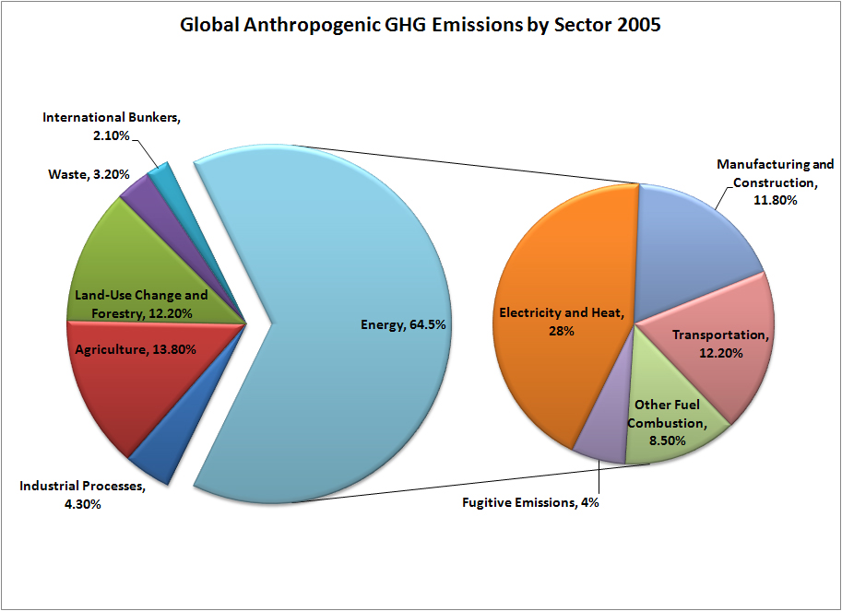
Source: Climate Analysis Indicators Tool, World Resources Institute
Notes:
Based on this data, it becomes clear that energy production and usage are the largest contributor to GHG emissions. That leads us into our next section on electrical energy production – where does it come from?

Slide 19
References
IPCC Summary Report for Policy Makers. 2014
IPCC Summary Report graphics. 2014
"About IPCC." IPCC - Intergovernmental Panel on Climate Change. 20 Apr. 2009 <http://www.ipcc.ch/about/index.htm>.
"Climate Change | U.S. EPA." U.S. Environmental Protection Agency. 20 Apr. 2009 <http://epa.gov/climatechange/index.html>.
Rischard, J. F. High Noon: Twenty Global Problems, Twenty Years to Solve Them. New York: Basic Books, 2002.
Presentation created by Cindy Barnes, 2015

